Slide 1


Climate Change and its Impact on Children
Killer childhood diseases are spreading more due to environmental degradation and climate change. Children are particularly vulnerable to these changes, suffering from increased air pollution, extreme heatwaves, and disrupted education. The mental health of children and adolescents is also affected by extreme heat.
SM
by Sampad Mohapatra

Slide 2
The Impact of Air Pollution on Children
Vulnerable to Air Pollution
Extreme Heatwaves
Children are more likely to suffer from air pollution than adults, with detrimental effects on their respiratory health.
Infants and young children are less able to regulate their body temperature, making them more vulnerable during extreme heatwaves.
Rising Food Prices and Malnutrition
Disrupted Education
Forty million children have their education disrupted every year due to disasters exacerbated by climate change.
Child malnutrition is worsened by crop failures and rising food prices caused by climate change.

Slide 3

The Mental Health Impact of Extreme Heat
1
Mental Health Problems
High temperatures are associated with an increase in mental health problems, including posttraumatic stress disorder and depression, in children and adolescents.
2
Psychological Impact
Extreme heat can create distress and anxiety among children, impacting their overall well-being.
3
Long-term Consequences
Prolonged exposure to extreme heat can have long-lasting effects on mental health, potentially affecting future generations.

Slide 4
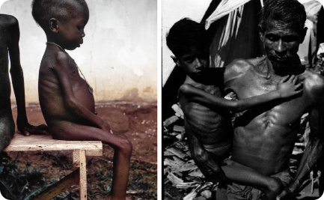

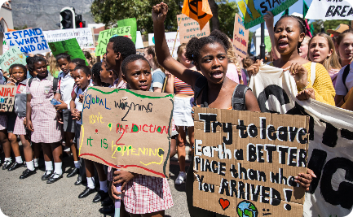
Climate Change and Child Nutrition
Food Insecurity
Dehydration Risks
Disrupted Education
Crop failures and rising food prices, driven by climate change, worsen child malnutrition.
During extreme heatwaves, children are more prone to dehydration, leading to increased health risks.
Climate change-related disasters disrupt the education of millions of children, aggravating child malnutrition.

Slide 5

Protecting Children in a Changing Climate
1
Educate Parents and Caregivers
Providing information and resources to parents and caregivers on protecting children's health during climate change is crucial.
2
Invest in Climate-Resilient Infrastructure
Building climate-resilient infrastructure ensures that children have access to safe environments and essential services.
3
Advocate for Policy Changes
Advocating for policies that address the root causes of climate change can help protect children from its detrimental impacts.

Slide 6

Building Resilience in Children
1
Promote Climate Literacy
Educating children about climate change and its impacts empowers them to be agents of change in their communities.
2
Encourage Sustainable Habits
Teaching children eco-friendly practices, such as recycling and conserving energy, instills lifelong sustainable habits.
3
Foster Resilience
Building emotional resilience in children equips them to cope with the challenges posed by climate change.

Slide 7
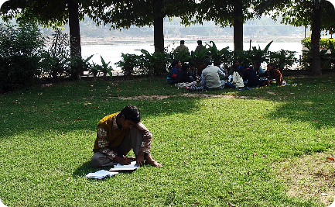
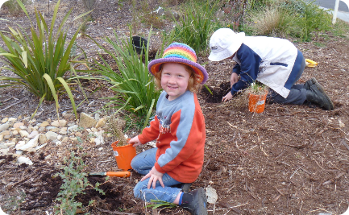

Global Collaboration for Children's Future
Education for Sustainability
Environmental Stewardship
Collective Action
Promoting collective action empowers children to advocate for a sustainable future and hold leaders accountable.
Prioritizing education for sustainability equips children with the knowledge and skills needed to address climate change.
Encouraging children to engage in environmental stewardship activities fosters a sense of responsibility towards the planet.

Slide 8
Conclusion: Protecting the Most Vulnerable
Climate change poses significant threats to children's health, education, and well-being. It is essential that we prioritize their protection through education, policy changes, and sustainable practices. Together, we can build a resilient and sustainable future for all.

